Slide 1

Sign language detecttion and translatioon system
By-
Palla Praveen Reddy
Rayala Vikyath
Shyamala Hari Prasad

Slide 2
Introduction
The Sign Language Recognition and Translation System is an AI-powered application designed to bridge the communication gap between the hearing-impaired and the hearing population. Using computer vision and deep learning techniques, the system recognizes hand gestures corresponding to American Sign Language (ASL) alphabets from a webcam feed.

Slide 3
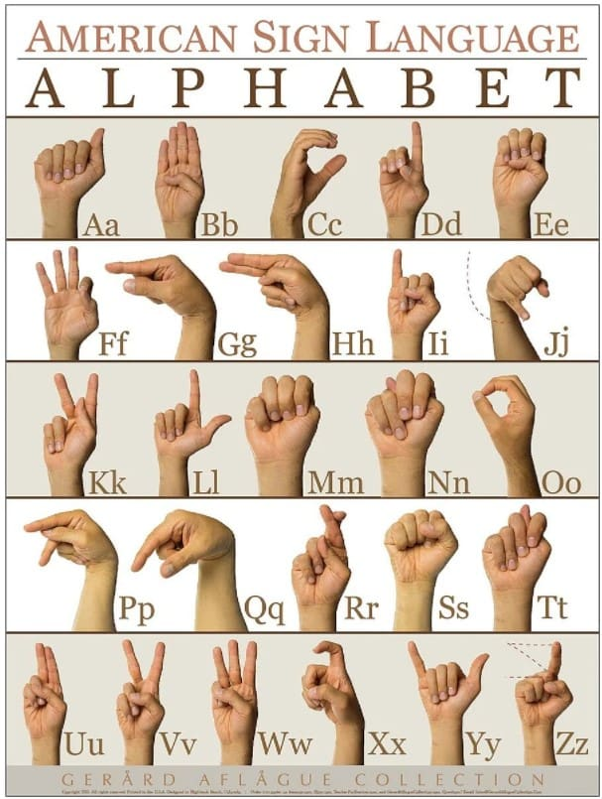
Objective
To develope a system for automatic translation of staticgestures used by dumb and def persons into audible speech understand by common person

Slide 4
Data used
📂 project/
├── 📂 images/
│ └── 📂 asl_alphabet_train/
│ ├── 📂 A/
│ ├── 📂 B/
│ ├── 📂 C/
│ ├── ...
│ ├── 📂 Z/
│ ├── 📂 del/
│ ├── 📂 nothing/
│ └── 📂 space/
│
├── 📂 data/
│ ├── 📂 A/
│ ├── 📂 B/
│ ├── ...
│ └── 📂 Z/
Dataset: ASL Alphabet Dataset (A-Z, space, delete, nothing).
Contains thousands of labeled images for training.
https://www.kaggle.com/grassknoted/asl-alphabet

Slide 5
System architecture
Capture live video feed from webcam.
Extract hand gesture Region of Interest (ROI).
Preprocess image and feed to CNN model for prediction.
Build words from recognized letters.
Convert text to speech for audio output.

Slide 6
Model development
Convolutional Neural Network (CNN) trained on ASL images.
Input: 64x64 pixel images of hand gestures.
Output: Predicted letter from the ASL alphabet.
Achieves high accuracy with proper training and augmentation.

Slide 7
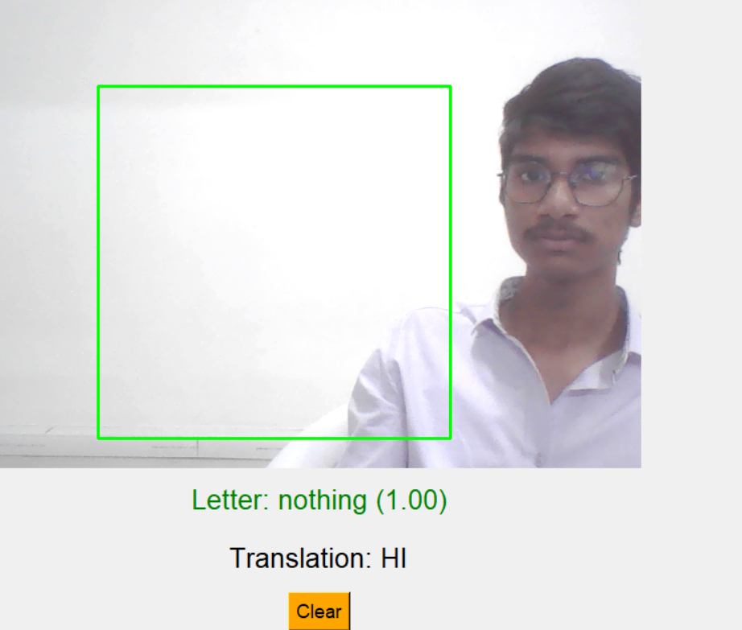
User interface
Developed with Tkinter (or PyQt).
Displays webcam feed and detected letters in real-time.
Shows translated word/sentence on screen.
Buttons to clear translation and exit.
Audio toggle to enable or disable voice output.

Slide 8
Data Analysis
ariations in lighting and background affect prediction accuracy.
Similar hand gestures can confuse the model.
Added prediction delay and threshold to improve reliability.
Used image preprocessing and ROI selection for better results.

Slide 9
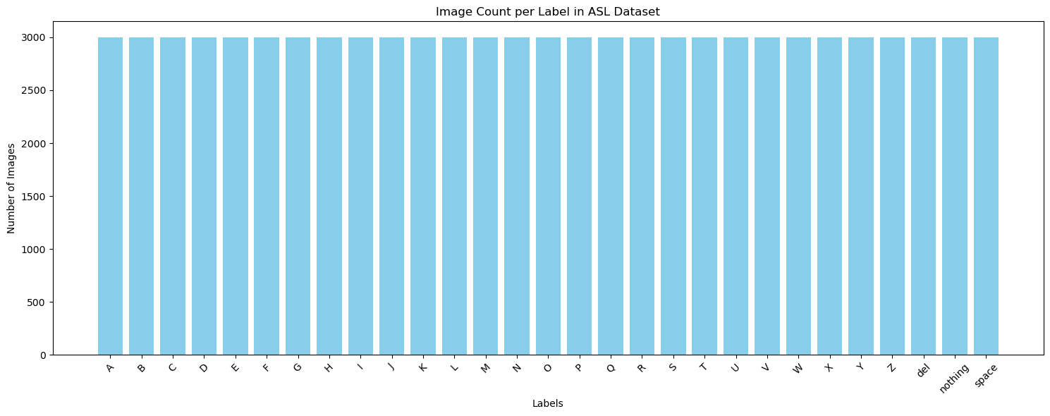

Slide 10
Conclusion
Successfully developed a system for ASL recognition and audio translation.
Enables better communication for hearing-impaired individuals.
Future enhancements: Sentence recognition, support for other sign languages, mobile app development.

Slide 11
Thank you

